Slide 1
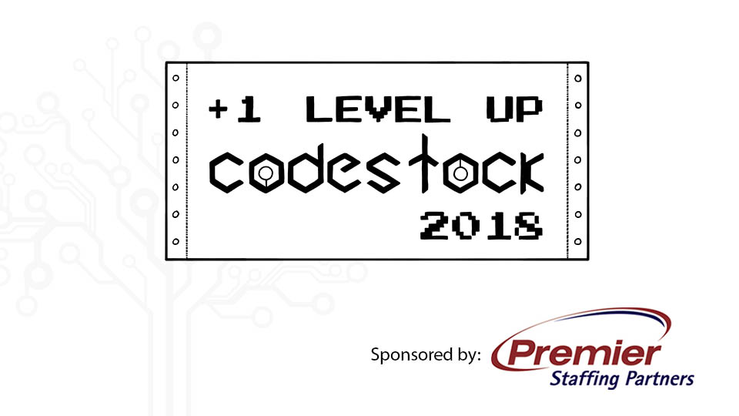

Slide 2
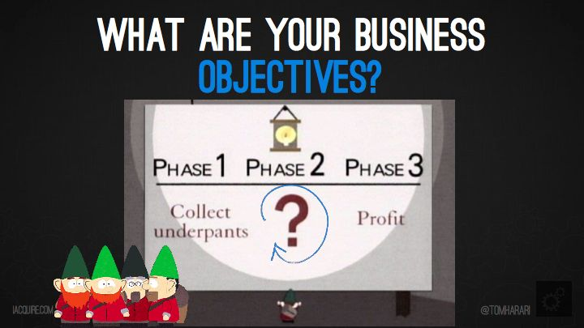
Title: Phase 1. Code; Phase 2….; Phase 3. DevOps!!!!
Notes:
Sr. Systems Engineer @ Pilot Flying J
Bachelors in Business Admin from UT focused on Enterprise Management
EODT>ITIL
ITIL inspired Lean merging with IT
ITIL describes service lifecycle

Slide 3

Tommy Neubauer
Notes:
Sr. Systems Engineer Pilot FlyingJ
My role morphed from infrastructure to devops
Mobile app
AWS
Chef
TAKE Some time to talk about how you got here

Slide 4
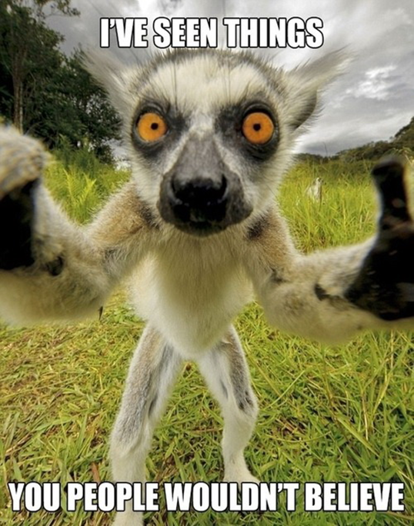
Notes:
Mainly the difference between devops and trying to put it in a waterfall approach for large batches

Slide 5
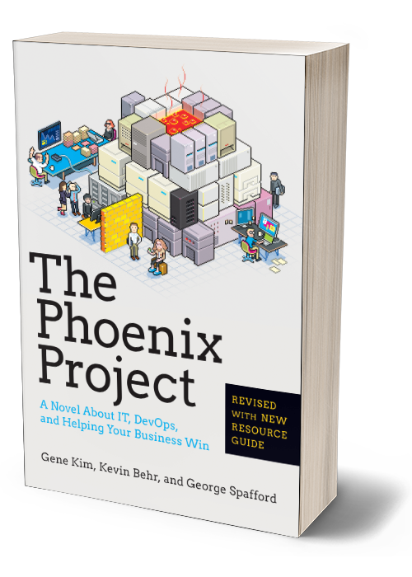
The Phoenix Project
Notes:
If you’re hear you probably read it already
Did you read The Goal after?
The Phoenix Project is almost exactly a rewrite of The Goal from an IT prospective
Go read The Goal if for no other reason than the visualization of the metaphor that IT/Development is really just an abstract of manufacturing

Slide 6
DevOps
What is it really?
Lean Ops for IT
  Enables Agile
  A thought process leveraging the “Three Ways”
  CI/CD
  Config Management
  Collaboration
  STANDARDIZATION!!!!!
Notes:
What do we mean when we say 3 ways? – Ways of doing and looking at work

Slide 7
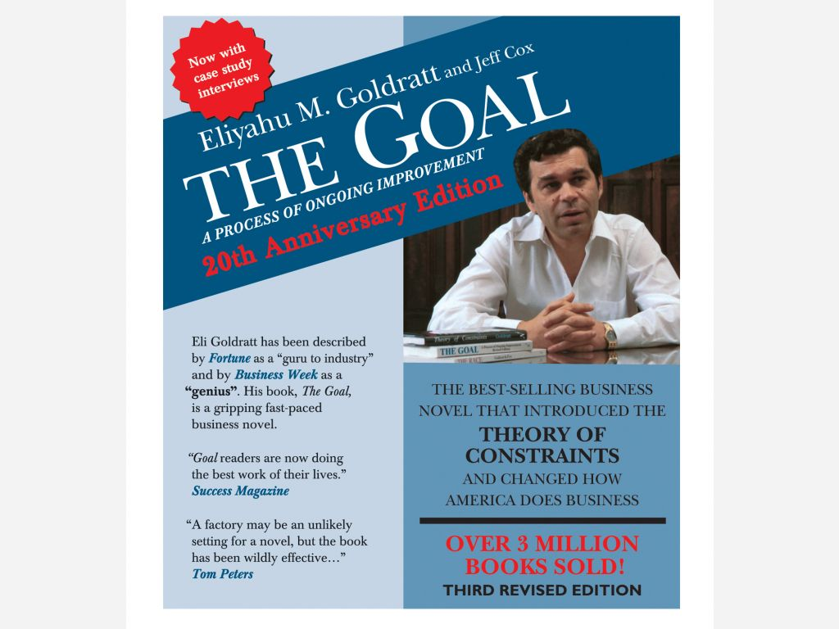
The Goal
Notes:
Read before phoenix project

Slide 8
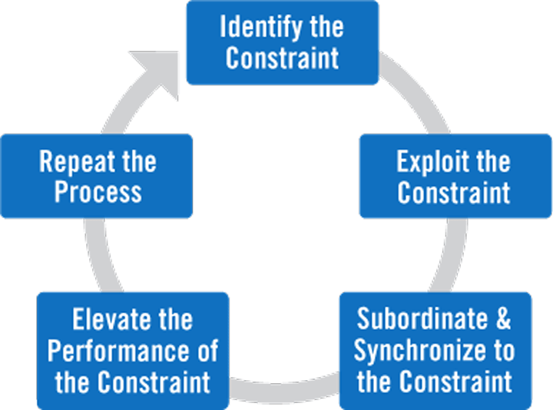
Notes:
Theory of constraints
Five focusing steps
DevOps wants to add visibility into this and allow control over the constraint
And lets us make sure the developer is the constraint
Why do we want it there?
---next slide

Slide 9
Identify constraint
Find the one part of your process that is causing work to slow down THE MOST
Map out the process and analyze it
  Look for ways to add visibility
  Start using troubleshooting 101 – if we remove this do things move faster?
Notes:
IS IT
PHYSICAL- equipment, people, material, space
POLICY-required ways of doing work (aka your pipeline’s shape)
PARADIGM- deeply engrained beliefs (aka developers must always be writing code)
MARKET- production is outpacing demand

Slide 10
Exploit constraint
Make the most of what you have
Are there ways to optimize this constraint?
Notes:
This could be primarily policy driven
But think out dated hardware being used again to break the constraint
Measure Overall Equipment Effectiveness (Availability, Performance, Quality)
Prevent errors from coming in
Is security getting over run with people asking how to write good code?

Slide 11
Subordinate and synchronize
Everything else should support this constraint or work center and work should be held back from upstream activities until things move at a rate that it can be processed
Drum-Buffer-Rope
Notes:
Drum is the constraint
Buffer is the level of inventory needed to maintain consistent production
Rope is the signal generated by the constraint indicating that some amount of inventory has been consumed

Slide 12
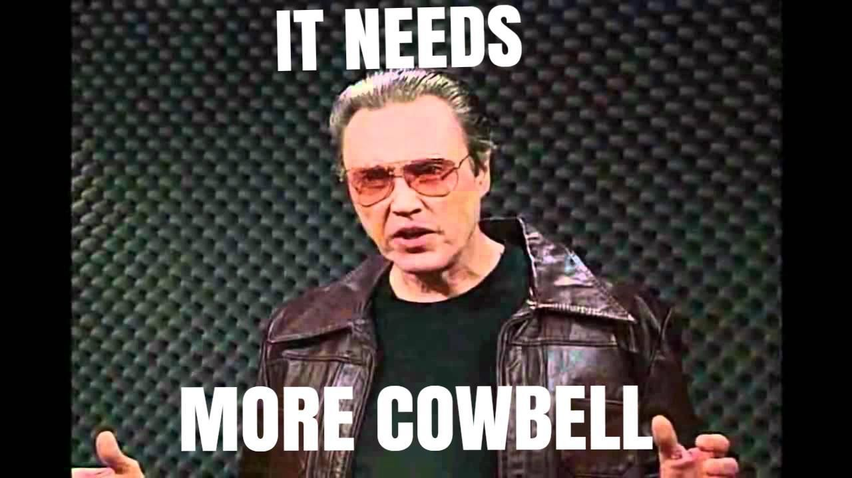
Elevate performance
Notes:
Give it whatever it needs
Capital investment may be necessary

Slide 13
Notes:
Theory of constraints
Five focusing steps
DevOps wants to add visibility into this and allow control over the constraint
And lets us make sure the developer is the constraint
Why do we want it there?
---next slide

Slide 14
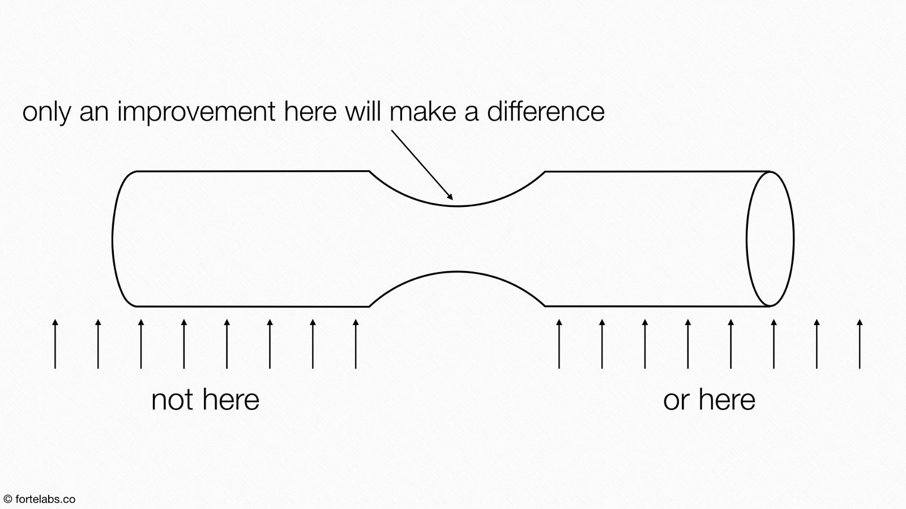
Notes:
Any improvement that isn’t at the constraint is an illusion

Slide 15
Manufacturing to DevOps Translation
Ford
Toyota
Tesla
Local Motors
Notes:
3 of these represent the 3 ways
One is what happens when you misunderstand devops

Slide 16
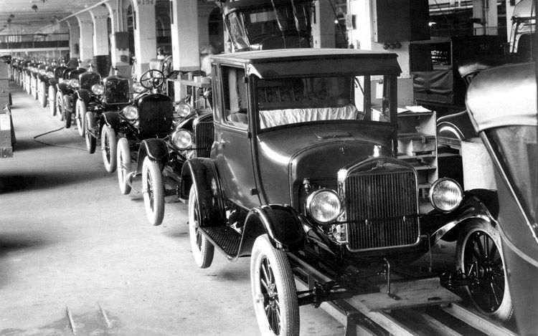
Notes:
First Way
Systems Thinking – W. Edwards Deming 1940-1970
Ford Assembly Line
Ford Model T and black paint
This is about making the whole system stronger not the silos
Go read “The Critical Chain” to really dive into this from a project management perspective
Whatever you do DON’T STOP HERE

Slide 17
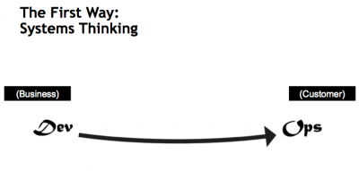
What’s Wrong with This
Notes:
There is no Feedback loop.

Slide 18
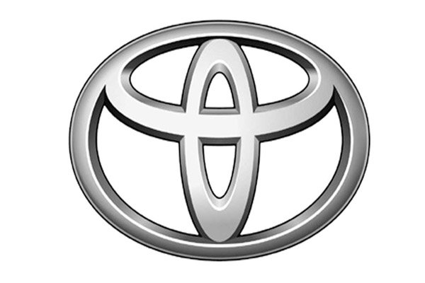
Notes:
SECOND WAY
Long-term philosophy[edit]
Base your management decisions on a long-term philosophy, even at the expense of short-term financial goals.
The right process will produce the right results[edit]
Create continuous process flow to bring problems to the surface.
Use the "pull" system to avoid overproduction.-Kanbaan
Level out the workload (heijunka). (Work like the tortoise, not the hare.) - CI/CD
Build a culture of stopping to fix problems, to get quality right from the start.(Jidoka) – CI/CD
Standardized tasks are the foundation for continuous improvement and employee empowerment.
Use visual control so no problems are hidden.
Use only reliable, thoroughly tested technology that serves your people and processes.
Add value to the organization by developing your people and partners[edit]
Grow leaders who thoroughly understand the work, live the philosophy, and teach it to others.
Develop exceptional people and teams who follow your company's philosophy.
Respect your extended network of partners and suppliers by challenging them and helping them improve.

Slide 19
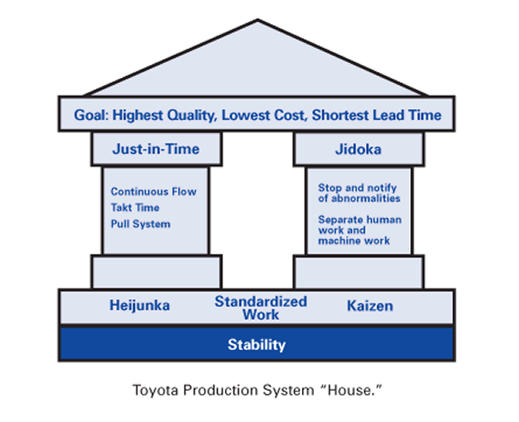
-Lean.org
Notes:
Lean and Toyota Production System are synonymous
Toyota uses Jidoka to stop abnormalities
And Kaizen to reflect on wins/losses

Slide 20
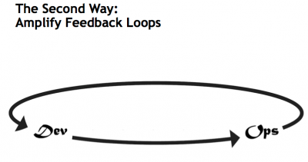
Better
Notes:
This is important because for the first time we talk about feedback
The first way stops with what looks like a line
The Second Way is about shortening and amplifying all feedback loops from all customers

Slide 21
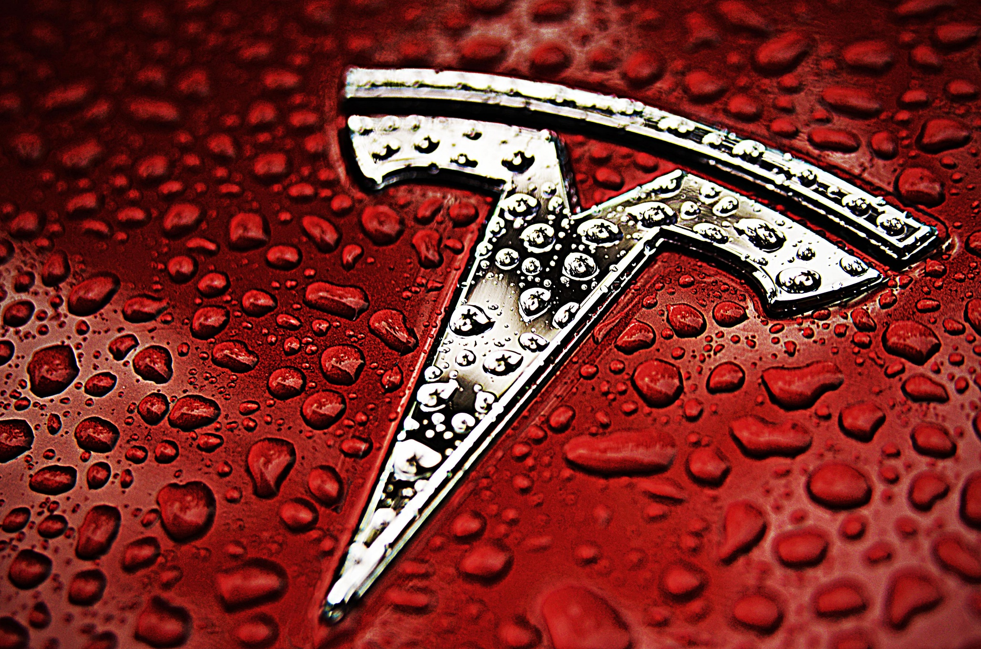
Notes:
Tesla wanted to Hyper automate their new “Gigafactory”
The Gigafactory was thought as a product in and of itself
Robots can do it more reliably and cheaper

Slide 22
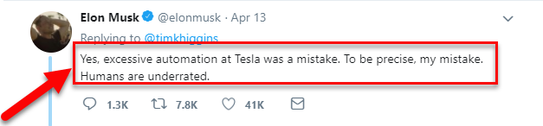
Notes:
WRONG!!!
They should be used as tools to augment people
There is no automation without understanding
Tesla’s big problem
Hyper-Automation, Bernstein
Toyota vs. Tesla

Slide 23

Local Motors
Notes:
8 years for an innovation to get into a vehicle in a typical automaker
Build your own and dream up changes in “the forge”
This is where it all comes together
This is also the hardest part
The Culture of Continual Experimentation and Learning

Slide 24
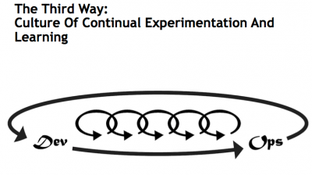

Slide 25
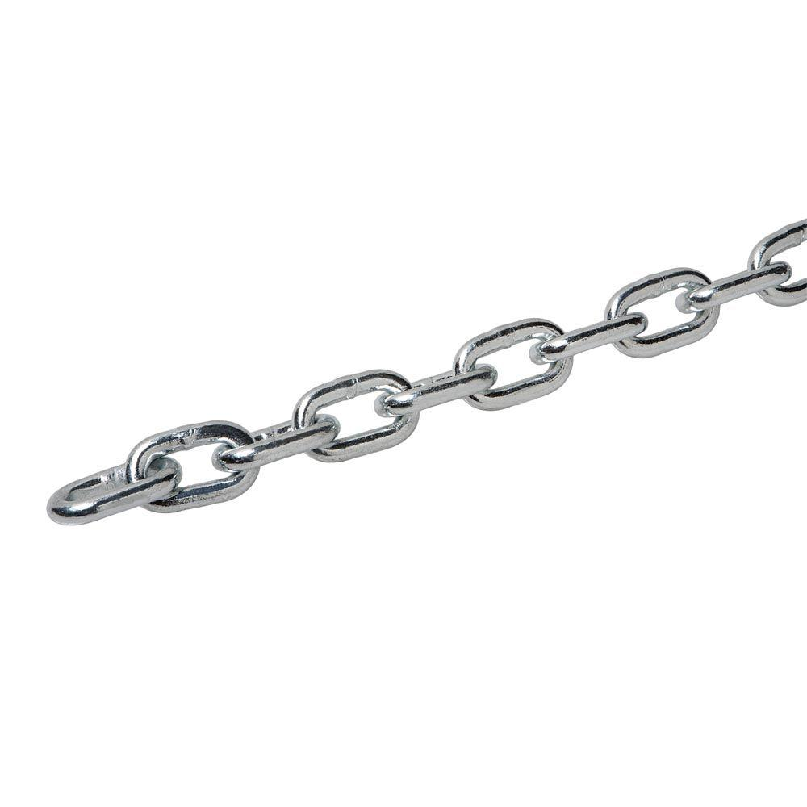
Notes:
The third way should look somewhat like a chain
the TOC shows us that any improvement anywhere other than the bottleneck aka the weakest link is an illusion

Slide 26
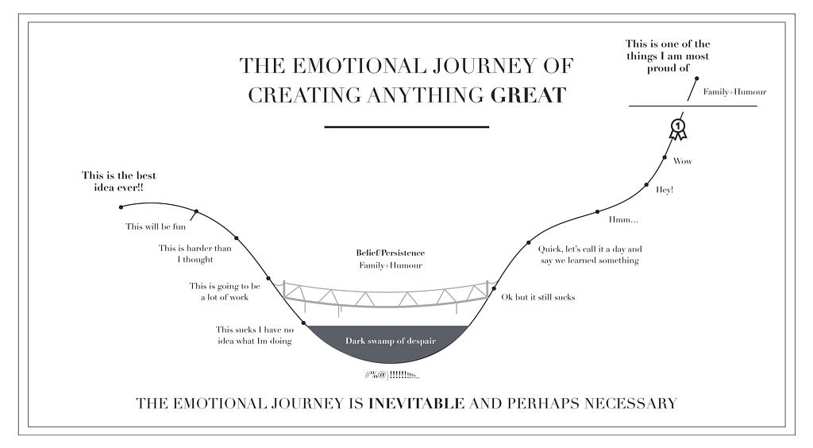
Notes:
Places for help
-KnoxDevs
-League of Professional System Administrators (LOPSA)
-Conferences like this

Slide 27
Failing
Fail early, and fail often
How we learn from failure
Encourage people to admit it and teach from it
Populate a Wiki
Notes:
Fail in dev not in Prod
Distinguish between good and bad failure

Slide 28
Pitfalls
Exceptions to the pipeline and expediting
    This eliminates all checks and balances that are there for a reason
    If everything is an emergency nothing is
Rework/Unplanned work
    The opposite of work is unplanned work
    This can be introduced by:
      Poor quality deliverables
      Managers bypassing the change management pipeline
    A major goal should be to reduce this through strict process to reduce volatility
Over Automation

Slide 29
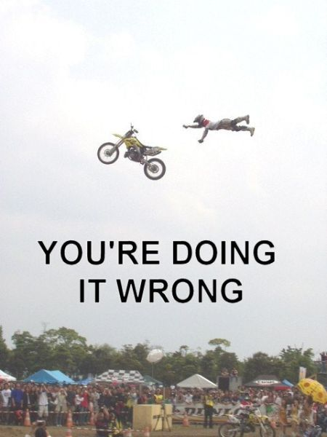
Notes:
Toolset not one tool

Slide 30
DevOps Stacks Tools
Config management tools
  Chef
  Puppet
  Ansible
CI/CD
  VSTS/TFS
  CodeDeploy/CodeBuild
  Team City
  Bamboo
Source Control
  Github
  BitBucket
  TFS/VSTS
Artifact Repository
  Artifactory
  CA Automic
Logging/Monitoring
  This could be a whole separate presentation
Notes:
Test Drive the tools
And design the system

Slide 31
Submit Code
Delivery review to Chef Automate
Code is tested for syntax
Merged to BitBucket
Code is built and tested
Pushed To Artifactory after tests are passed
Artifact is Deployed
Chef delivers code to the selected environment
Notes:
Very simple pipeline example

Slide 32
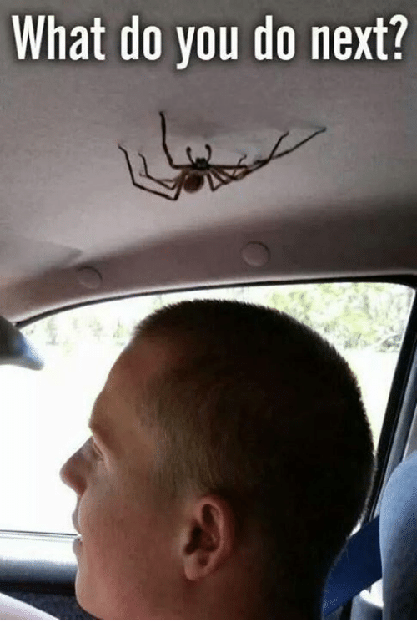
Notes:
-Go define your process
-find the tools you would like to use
-continuously monitor your bottleneck
-Ask for help

Slide 33
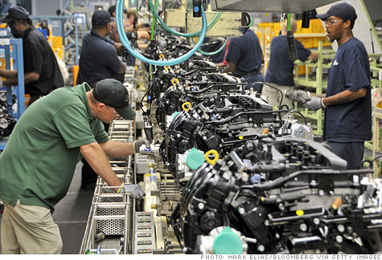
Notes:
Go define your process
What does a build look like
Who looks at it before it gets deployed
How do you deploy it

Slide 34
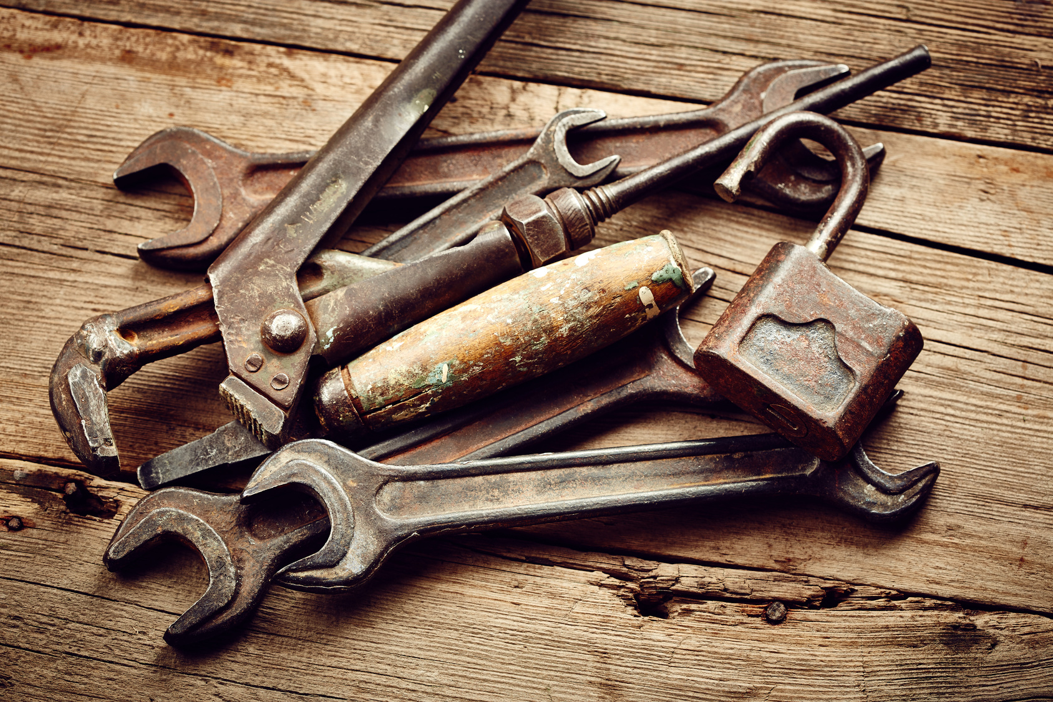
Notes:
find the tools you would like to use
What builds
What do you want to drive the pipeline
Where do you put things to hold them to run them to inspect them?

Slide 35

Notes:
-continuously monitor your bottleneck
Check this regularly to make sure that your bottle neck is where you want it.

Slide 36
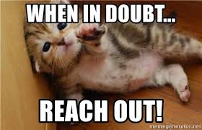
Notes:
Ask for help
http://knoxdevs.com/
http://web.lopsaetenn.org/
https://www.meetup.com/DevOps-Knoxville/
https://xenscaler.com – my blog
@medwiz – twitter

Slide 37
References
The Goal – By Eliyahu Goldratt
  https://www.amazon.com/Goal-Process-Ongoing-Improvement/dp/0884271951
The Phoenix Project – By Gene Kim
  https://www.amazon.com/Phoenix-Project-DevOps-Helping-Business/dp/0988262592
The Critical Chain – By Eliyahu Goldratt
  https://www.amazon.com/Critical-Chain-Eliyahu-M-Goldratt/dp/0884271536
http://knoxdevs.com/
http://web.lopsaetenn.org/
https://www.meetup.com/DevOps-Knoxville/
https://xenscaler.com – my blog
@medwiz – twitter
Notes:
http://knoxdevs.com/
http://web.lopsaetenn.org/
https://www.meetup.com/DevOps-Knoxville/
https://xenscaler.com – my blog
@medwiz – twitter

